Slide 1
Making this resource work for you
Prior to teaching this lesson, please refer to the ‘Unit Overview and Planning Document’.
Further guidance on planning Science Mastery lessons can be found in the detailed planning guidance document.
Refer to the ‘notes’ section on each slide for useful information, including suggested expositions, pedagogical content knowledge, suggested questions, answers and more. Consider using presenter mode so you can see this guidance throughout the lesson.
The introduction slides can be adapted to suit your teaching style and the needs of your class.
Before the lesson, adapt the fix-it slide to address any misconceptions identified in the previous lesson’s exit ticket.
Choose from the suggested activities to suit your class. The intention is not that you complete all of these, but that you select those which ones are most appropriate for your students. It may be appropriate to further adapt activities for your students.
These lessons are designed to occupy approximately 1 hour. To adapt for a shorter or longer lesson duration we advise you to adapt the activity section accordingly.
Please consider using the final slide to send feedback about this lesson or examples of PowerPoints that you have adapted to our design team. Your feedback is used to improve Science Mastery for all of our teachers and students. We appreciate all suggestions and comments.
Thank you for reading!
The Science Mastery Team

Slide 2
Feedback Lesson
Answer the questions below.
Explain the difference between eukaryotic and prokaryotic cells.
Explain the difference between active transport and diffusion.
Describe the process of cell division.
State the equation to calculate magnification of an image.
Eukaryotic cells contain a nucleus, prokaryotic cells contain their DNA in plasmids or loops.
Diffusion is the net movement of molecules from high concentration to low concentration and is a passive process (does not require energy), whereas active transport is the movement of molecules from low concentration to high concentration and requires energy.
Cells replicate their DNA and subcellular structures before chromosomes are pulled to separate ends of the cell before the cytoplasm and membrane split to form two identical daughter cells.
$Magnification= \frac{Size of image}{Size of actual object}$
Notes:
Foundation: State the similarities between plant and animal cells
Stretch: Explain why prokaryotic cells cannot undergo mitosis.
Answers:
Foundation: Plant cells contain a cell wall, chloroplasts and a vacuole.
Stretch: Mitosis is the splitting of the genetic material in the nucleus and prokaryotic cells do not have a nucleus.

Slide 3
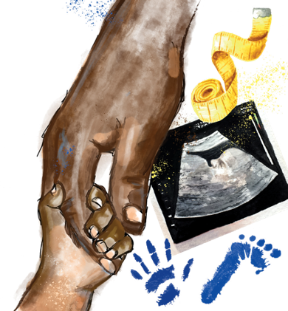
B3.1.15
04/10/2024
Feedback Lesson
B3.1.1 Prior Knowledge Review
B3.1.2 Eukaryotic and Prokaryotic Cells
B3.1.3 Aseptic Technique
B3.1.4 Growth of Bacteria
B3.1.5 Microscopes
B3.1.6 Observing Cells
B3.1.7 Diffusion
B3.1.8 Diffusion in Living Things
B3.1.9 Osmosis
B3.1.10 Osmosis Investigation
B3.1.11 Active Transport
B3.1.12 Cell Division
B3.1.13 Cancer
B3.1.14 Stem Cells

Slide 4
This is the fix-it portion of the lesson
The fix-it is an opportunity to respond to gaps in knowledge, especially those identified by the previous lesson’s exit ticket.
The teacher should customise this slide as needed, to facilitate
reteach, explanation, demonstration or modelling of ideas and concepts that students have not yet grasped or have misunderstood.
practise answering specific questions or of key skills.
redrafting or improving previous work.
Notes:
Purpose: to spend time on gaps identified in mastery quiz.

Slide 5
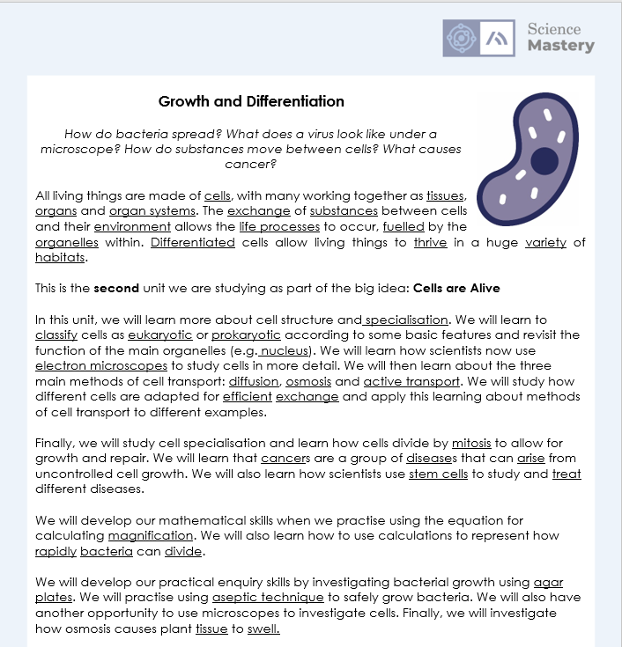
The Big Idea: Cells are Alive
Notes:
Purpose:. The purpose of this resource is to provide students with an overview at the beginning and end of each unit. It is designed to create a discussion about the unit prior to and at the end of the sequence of lessons.
Teacher guidance:
Pupils should be directed to the B3.1 Link to Big Ideas worksheet (either in their booklet or printed). This may be back at the beginning of the sequence of lessons.
Teachers should use guided reading techniques to read aloud with the pupils and then pupils should answer the reflection questions. This could be used to summarise what pupils have learnt.
Questions on the student sheet:
1. Tick off any words in the ‘words I haven’t seen before’ column that you are now confident with. Circle any you still need more practice to use.
2. What have you most enjoyed about this unit?
3. What more would you like to learn about the different types of cells as part of the big idea: ‘cells are alive’?
There are a range of ways to use this resource:
1. Display on a slide for students to read as a class. Direct students to complete the activities in their book.
2. Print off for students to stick into their book at the beginning of the unit along with their knowledge organiser. Complete as a guided reading task together. Direct students to complete the activities.
3. Have students complete as part of a booklet.
Set as a homework to reflect on the unit.
If you have any feedback about how this resource could be used/improved, please contact the science mastery team: sciencemastery@arkonline.org

Slide 6
Answers
Question | Answer
1
2
3
4
5
6
7
8
9
10a
10b
11
12
13
14
B
C
A
C
C
A
B
A
A
C
B
B
C
A
A
Notes:
Purpose: for students to correct their answers so they can see where they made errors and have a corrected quiz stuck in their books
Suggested guidance: talk through each question and cold call students to explore why the incorrect options are wrong. Students should write annotations on their marked quiz so they can revise from it.

Slide 7
Answers
Osmosis is the diffusion of water from a dilute solution to a concentrated solution through a partially permeable membrane
A lifestyle risk factor is a lifestyle choice that can increase the likelihood of a person developing a disease.
Notes:
Purpose: for students to correct their answers so they can see where they made errors and have improved their Section B answers.
Suggested guidance: talk through each question and cold call students to explore why the incorrect options are wrong. Students should write annotations on their marked quiz so they can revise from it.

Slide 8
Answers
3.
The cell cycle starts with a growth phase where the cell grows to double sub-cellular structures such ribosomes, cell membrane and DNA.
During mitosis DNA, arranged into chromosomes, is pulled to separate ends of the cell ready for division.
The final part of the cell cycle is when the cell membrane splits to produce two identical cells.
Notes:
Purpose: for students to correct their answers so they can see where they made errors and have improved their Section B answers.
Suggested guidance: talk through each question and cold call students to explore why the incorrect options are wrong. Students should write annotations on their marked quiz so they can revise from it.

Slide 9
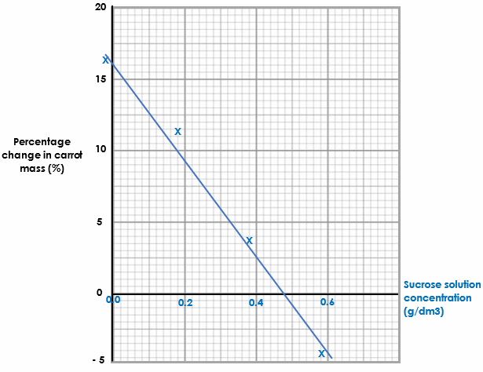
Answers
4.
Success criteria:
x-axis scale regularly spaced
x-axis correctly labelled
4 points plotted correctly
Line of best fit (straight line that aims to go through all the points)
Notes:
Purpose: for students to correct their answers so they can see where they made errors and have improved their Section B answers.
Suggested guidance: talk through each question and cold call students to explore why the incorrect options are wrong. Students should write annotations on their marked quiz so they can revise from it.

Slide 10
Complete your fix it task
Edit according to class performance on quiz
If you got Q1 or Q2 wrong…
Write the task instructions here. E.g. Complete X worksheet / write out the method / draw labelled diagrams of…
If you got Q3 wrong…
Write the task instructions here. E.g. Complete X worksheet / write out the method / draw labelled diagrams of…
If you got Q6 or Q7 wrong …
Write the task instructions here. E.g. Complete X worksheet / write out the method / draw labelled diagrams of…
Notes:
Purpose: for students to complete activities that improve their understanding of an aspect of the mastery quiz.
Guidance: These are not the only fix it tasks that might be appropriate but they are a starting point.

Slide 11
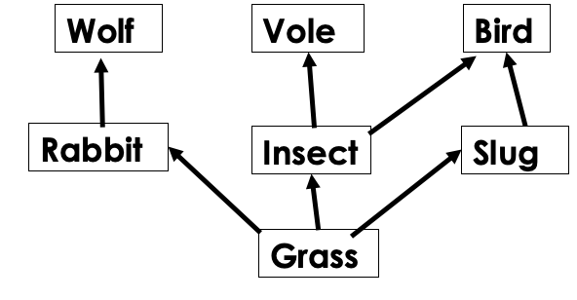
Growth and Differentiation Idea Web
Content to include:
Eukaryotic and prokaryotic cells
Specialised Cells
Microscopes
Diffusion
Osmosis
Active Transport
Cell division
Cancer
Stem Cells
All of the ideas covered in this unit link to each other
Create a web to show how each concept is related to the other
Your web should look like a food web with concepts ‘feeding off’ previous concepts
There may be more than one arrow coming to or going from different topics
Annotate your web to explain where you have placed arrows
Which knowledge would be the producer?
Notes:
Purpose: students practise using and applying their knowledge from the unit by consolidating and linking ideas. Metacognitive practice of linking knowledge and how it fits into bigger picture.
Ask students to include their rationale to explain why content is connected.
Scaffolding suggestion – give pupils a couple of links to start off with, or complete a web as pairs/small groups

Slide 12
Answer the questions below.
Plant and animals cells…
A. Can only be seen under an electron microscope
B. Are examples of eukaryotic cells
C. Both contain a nucleus, cytoplasm and a cell wall
Diffusion is…
A. The movement of water molecules from high concentration to low concentration
B. The movement of molecules from low concentration to high concentration, requiring energy
C. The net movement of molecules from high concentration to low concentration
Cell division…
A. Is used in asexual reproduction
B. Always causes cancer
C. Produces 2 new cells with half the genetic information
✓
✓
✓
Notes:
Purpose: to find out if students are able to answer key questions that check for understanding of the residual knowledge in this lesson/unit. This will inform how much pupils have taken from this topic and concepts that may have to be recapped/retaught before next units.
Answers
Q1:B
Q2:C
Q3:A

Slide 13
Lesson B3.1.15
What was good about this lesson? | What can we do to improve this lesson?
Send us your feedback by clicking this link. Thank you!

